Slide 1


Introduction to Neural Networks and Natural Language Processing
Prof.dr.ir. Hans Henseler
Netherlands Forensic Institute
University of Applied Sciences Leiden
Extended DFRWS APAC Workshop,
October 29, 2023, Hong Kong University

Slide 2
Agenda
Time | Title
9:30 | Extra: Introduction to Neural Networks and Natural Language Processing
11:00 | Break
11:30 | Part I: Introduction Large Language Models
12:00 | Part II: Hands-on prompt engineering for digital forensics
12:30 | Lunch
14:00 | (part II continued)
14:30 | Part III: Hands-on with a LLM in a Google Colab notebook
15:30 | Break
16:00 | Part IV: Hands-on with Retrieval Augmented Generation
17:00 | End

Slide 3
Agenda
Time | Title
9:30 | Extra: Introduction to Neural Networks and Natural Language Processing
11:00 | Break
11:30 | Part I: Introduction Large Language Models
12:00 | Part II: Hands-on prompt engineering for digital forensics
12:30 | Lunch
14:00 | (part II continued)
14:30 | Part III: Hands-on with a LLM in a Google Colab notebook
15:30 | Break
16:00 | Part IV: Hands-on with Retrieval Augmented Generation
17:00 | End

Slide 4
Introduction to Neural Networks and Natural Language Processing
Extra module by Hans Henseler
Multi-layer back propagation
Word embeddings with Word2Vec
Generating text with Recurrent Neural Networks
Sentence embeddings and semantic search with BERT

Slide 5
A. Multi-layer back propagation
Gradiënt descent, generalized delta rule and tensors

Slide 6

Multi-layer network

Slide 7
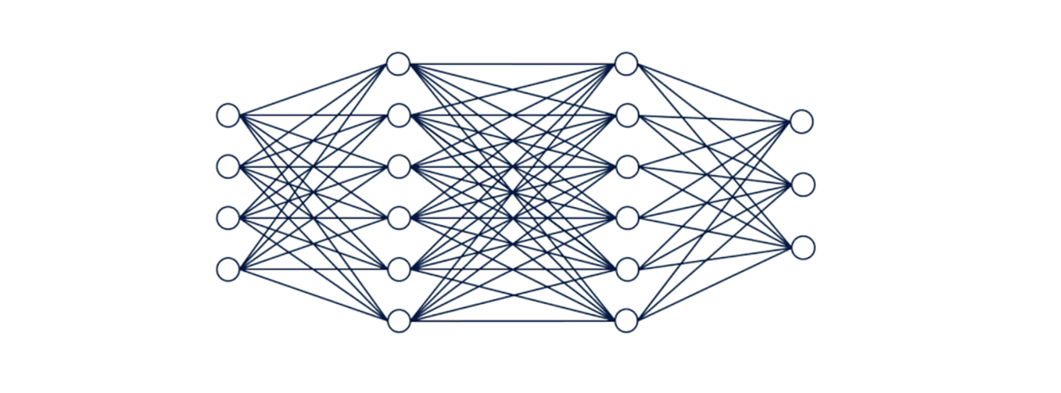
Forward propagation

Slide 8
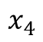
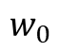
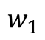
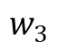
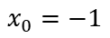
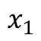
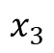
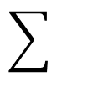
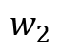
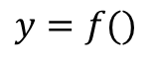
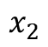
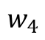
Neuron model
$$x_{1}$$
$$w_{1}$$
$$x_{2}$$
$$w_{2}$$
$$y=f()$$
$$x_{3}$$
$$w_{3}$$
$$w_{4}$$
$$w_{0}$$
$$x_{4}$$
$$x_{0}=−1$$

Slide 9
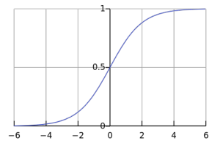
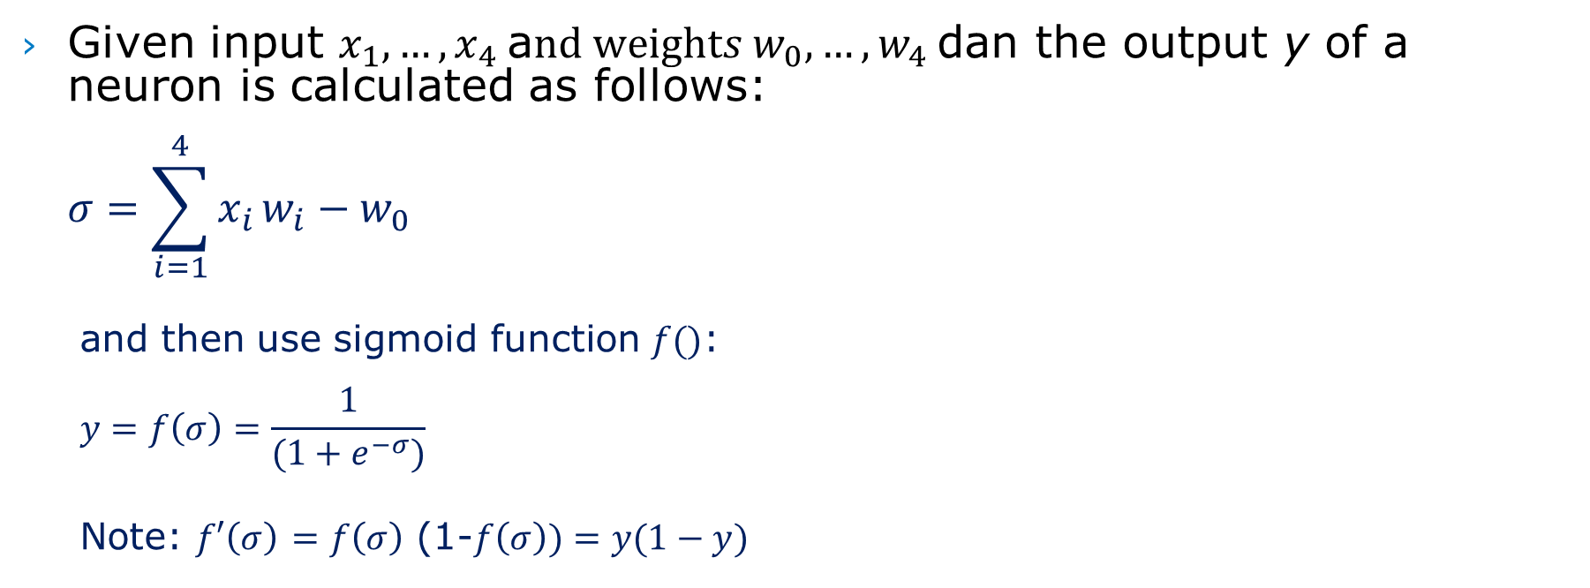
Forward propagation
Given input $x_{1},…, x_{4}$a$nd weights w_{0},…, w_{4}$dan the output y of a neuron is calculated as follows: $σ=\sum_{i=1}^{4}{x_{i}}w_{i}−w_{0}$
and then use sigmoid function $f()$: $$y=f\left(σ\right)=\frac{1}{(1+e^{−σ})}$$
Note: $f′\left(σ\right)$ $=f\left(σ\right)$ (1-$f\left(σ\right))=y(1−y)$
Sigmoid or softmax function

Slide 10
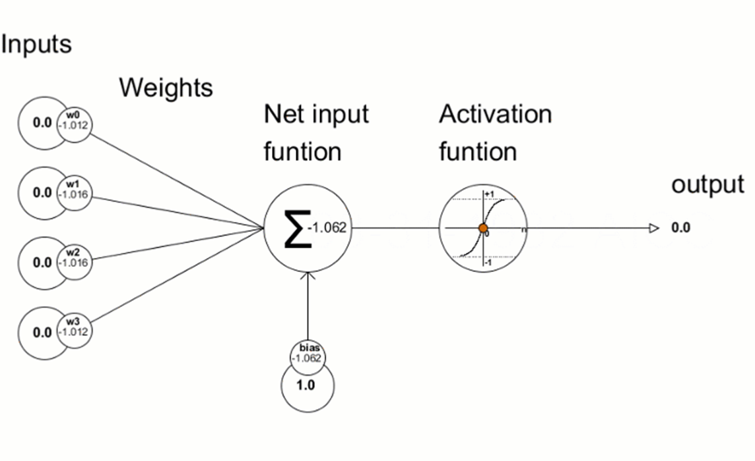
Neuron model (animated)

Slide 11
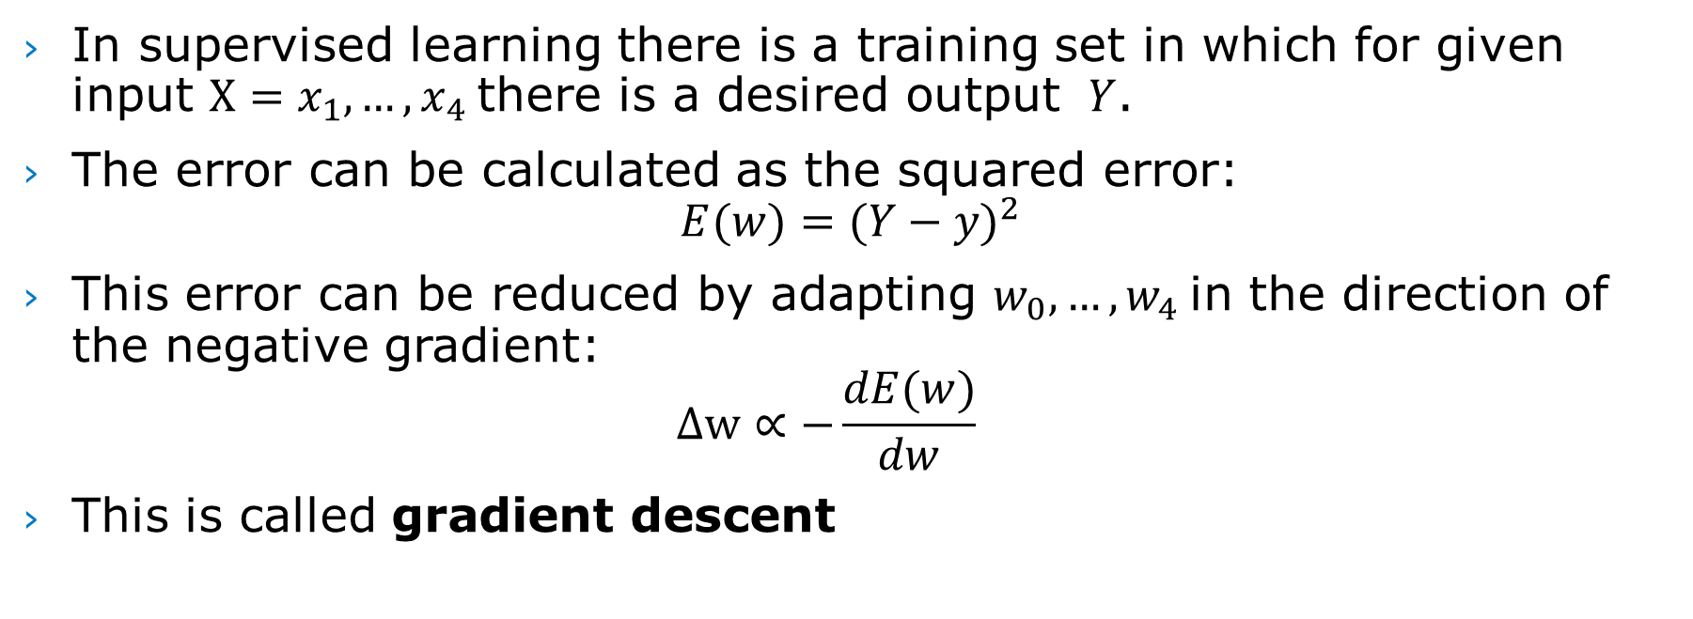
Gradient descent
In supervised learning there is a training set in which for given input $X=x_{1},…, x_{4}$there is a desired output $Y$.
The error can be calculated as the squared error: $E(w)={(Y−y)}^{2}$
This error can be reduced by adapting $w_{0},…, w_{4}$in the direction of the negative gradient: $∆w∝−\frac{dE(w)}{dw}$
This is called gradient descent

Slide 12
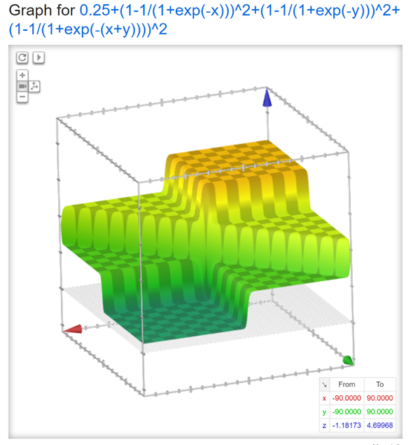
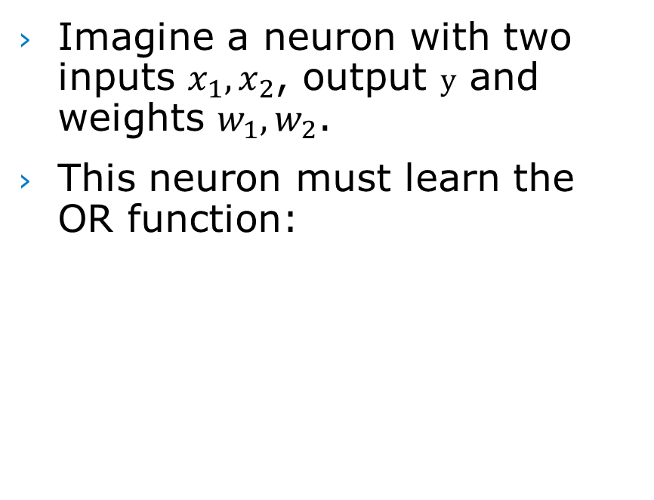
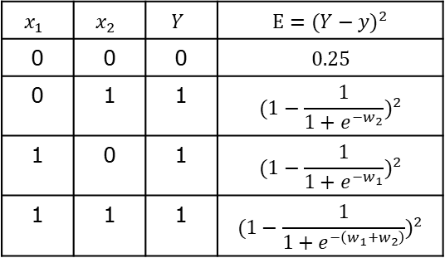
Gradient visualisation
Imagine a neuron with two inputs $x_{1},x_{2}$, output $y$ and weights $w_{1},w_{2}$.
This neuron must learn the OR function:
$$x_{1}$$ | $$x_{2}$$ | $$Y$$ | $$E={(Y−y)}^{2}$$
0 | 0 | 0 | $$0.25$$
0 | 1 | 1 | $${(1−\frac{1}{1+e^{−w_{2}}})}^{2}$$
1 | 0 | 1 | $${(1−\frac{1}{1+e^{−w_{1}}})}^{2}$$
1 | 1 | 1 | $${(1−\frac{1}{1+e^{−\left(w_{1}+w_{2}\right)}})}^{2}$$
Sum of E²: 0.25+(1-1/(1+exp(-x)))^2 +(1-1/(1+exp(-y)))^2 +(1-1/(1+exp(-(x+y))))^2

Slide 13
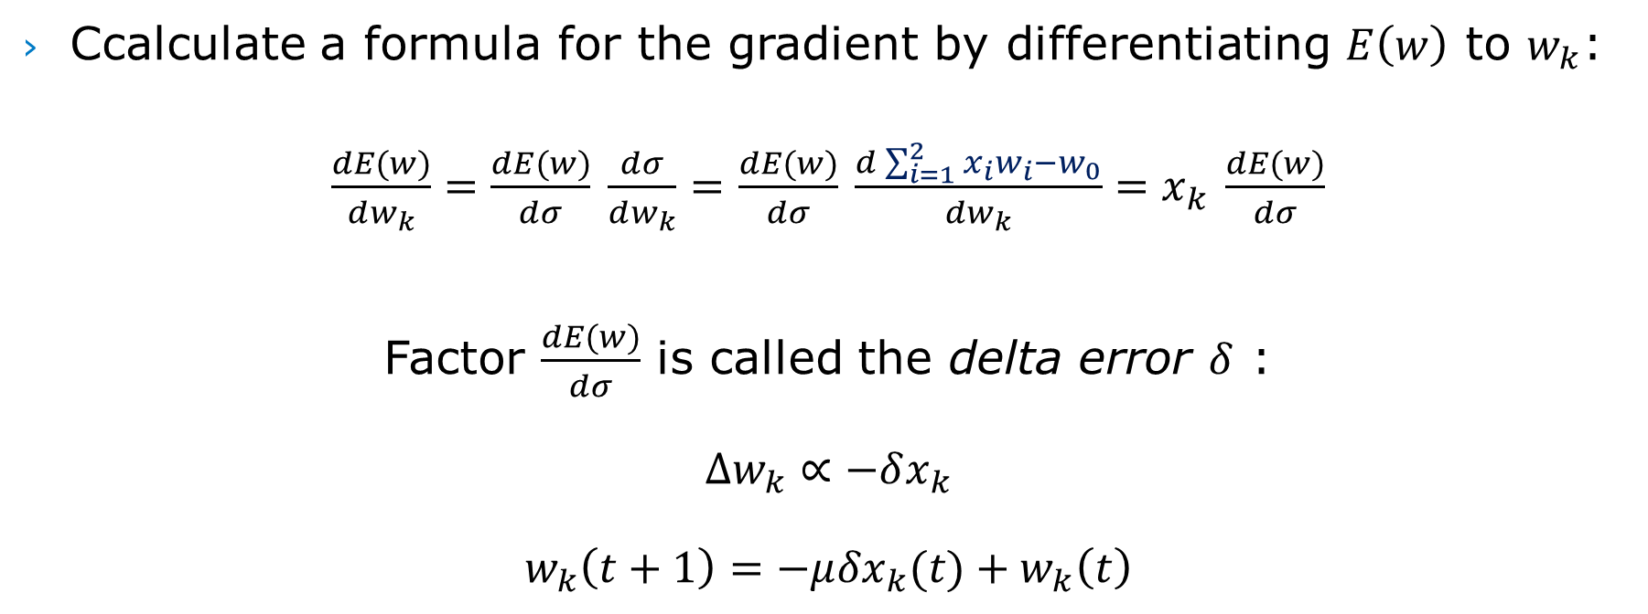
Delta rule
Ccalculate a formula for the gradient by differentiating $E\left(w\right)$ to $w_{k}$:
$\frac{dE(w)}{dw_{k}}=\frac{dE(w)}{dσ}$ $\frac{dσ}{dw_{k}}=$ $\frac{dE(w)}{dσ}$ $\frac{d\sum_{i=1}^{2}{x_{i}}w_{i}−w_{0}}{dw_{k}}=x_{k}$ $\frac{dE(w)}{dσ}$
Factor $\frac{dE(w)}{dσ}$ is called the delta error $δ$ : $$∆w_{k}∝−δx_{k} \\ w_{k}\left(t+1\right)=−μ{δx}_{k}(t)+w_{k}\left(t\right)$$

Slide 14
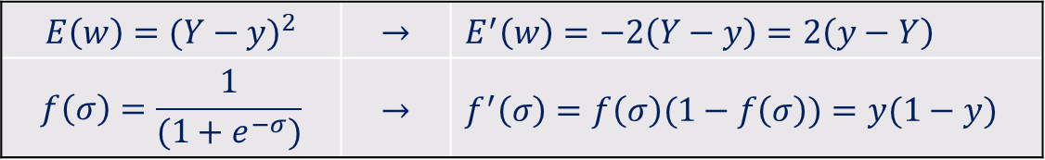
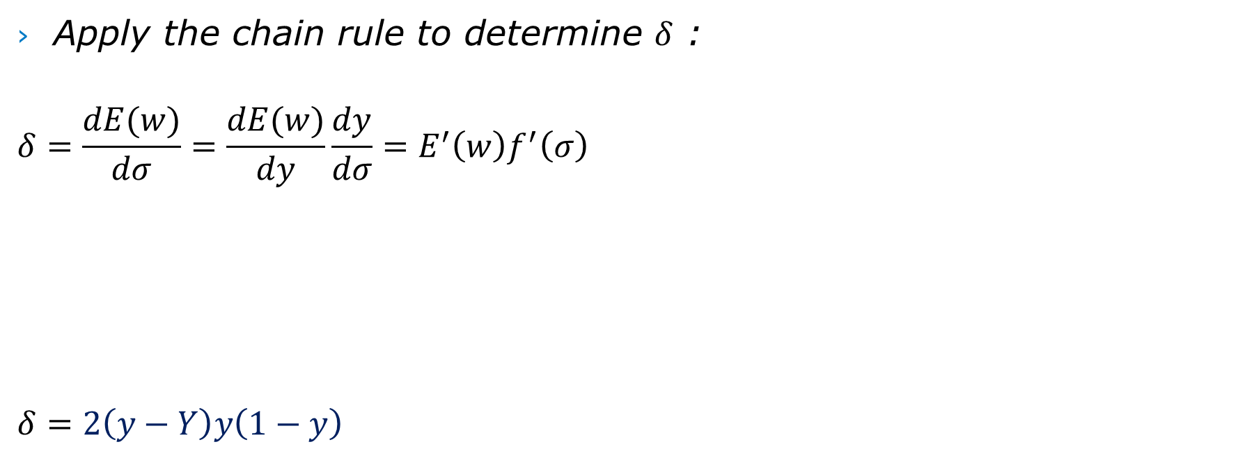
Delta rule (continued)
Apply the chain rule to determine $δ$ :
$$δ=\frac{dE(w)}{dσ}=\frac{dE(w)}{dy}\frac{dy}{dσ}=E^{′}\left(w\right)f^{′}\left(σ\right)$$
$$δ=2\left(y−Y\right)y\left(1−y\right)$$
$${E\left(w\right)=(Y−y)}^{2}$$ | $$→$$ | $$E^{′}\left(w\right)=−2\left(Y−y\right)=2\left(y−Y\right)$$
$$f\left(σ\right)=\frac{1}{(1+e^{−σ})}$$ | $$→$$ | $f^{′}\left(σ\right)=f\left(σ\right)(1−f\left(σ\right))=y(1−y)$

Slide 15
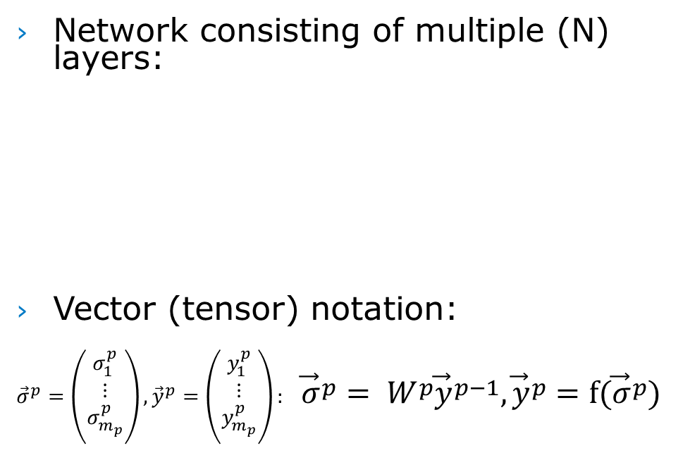
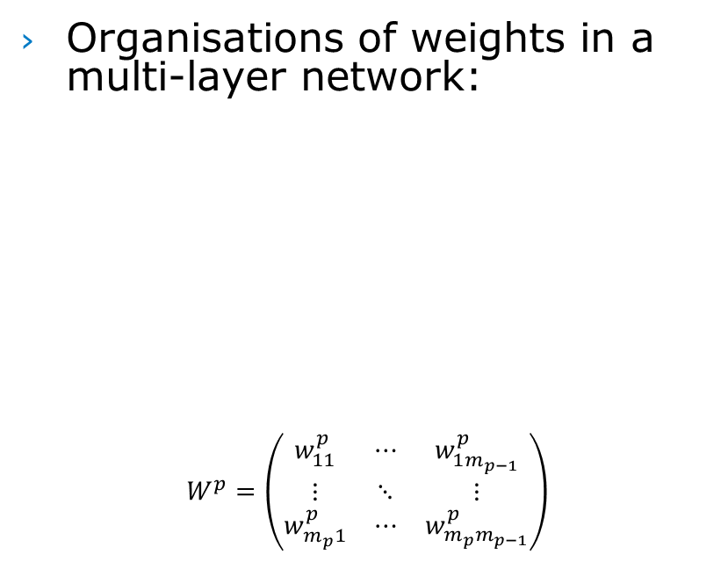
Multi-layer network
Network consisting of multiple (N) layers:
Vector (tensor) notation:
$${\vec{σ}}^{p}=\left({\begin{aligned}σ_{1}^{p} \\ ⋮\end{aligned} \atop σ_{m_{p}}^{p}}\right), {\vec{y}}^{p}=\left({\begin{aligned}y_{1}^{p} \\ ⋮\end{aligned} \atop y_{m_{p}}^{p}}\right): {\vec{σ}}^{p}= W^{p}{\vec{y}}^{p−1}, {\vec{y}}^{p}=f({\vec{σ}}^{p})$$
Organisations of weights in a multi-layer network:
$$W^{p}=\left(\begin{matrix}w_{11}^{p} & ⋯ & w_{1m_{p−1}}^{p} \\ ⋮ & ⋱ & ⋮ \\ w_{m_{p}1}^{p} & ⋯ & w_{m_{p}m_{p−1}}^{p}\end{matrix}\right)$$

Slide 16
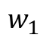
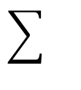
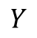
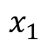
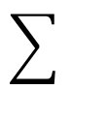
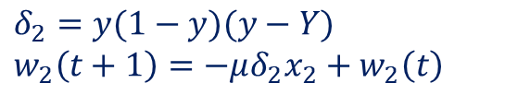
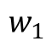
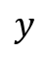
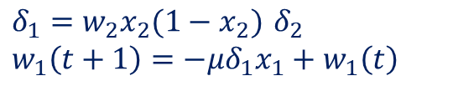
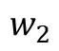
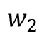
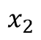
Generalized Delta Rule
By generalizing the delta rule we can train weights in hidden layers of the network:
$$x_{1}$$
$$x_{2}$$
$$y$$
$$w_{1}$$
$$w_{2}$$
hidden neuron
output neuron
$δ_{1}=w_{2}x_{2}(1−x_{2})$ $δ_{2}$
$$w_{1}\left(t+1\right)=−μδ_{1}x_{1}+w_{1}\left(t\right)$$
$$δ_{2}=y(1−y)(y−Y)$$
$$w_{2}\left(t+1\right)=−μδ_{2}x_{2}+w_{2}\left(t\right)$$
$$w_{1}$$
$$w_{2}$$
$$Y$$

Slide 17
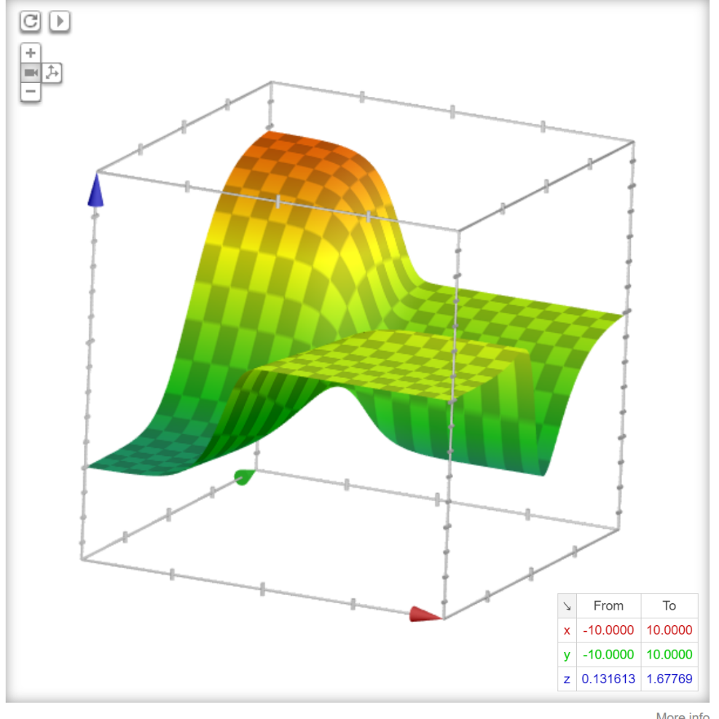
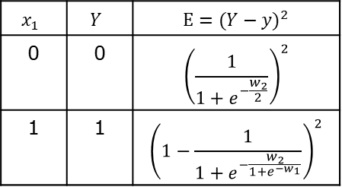
Gradient descent & local minima
Imagine the 1:1:1 network from the previous slide and that must learn the identity function:
$$x_{1}$$ | $$Y$$ | $$E={(Y−y)}^{2}$$
0 | 0 | $${\left(\frac{1}{1+e^{−\frac{w_{2}}{2}}}\right)}^{2}$$
1 | 1 | $${\left(1−\frac{1}{1+e^{−\frac{w_{2}}{1+e^{−w_{1}}}}}\right)}^{2}$$
Sum of E²=(1+exp(-y/2))^-2+(1-1/(1+exp(-y/(1+exp(-x)))^2

Slide 18
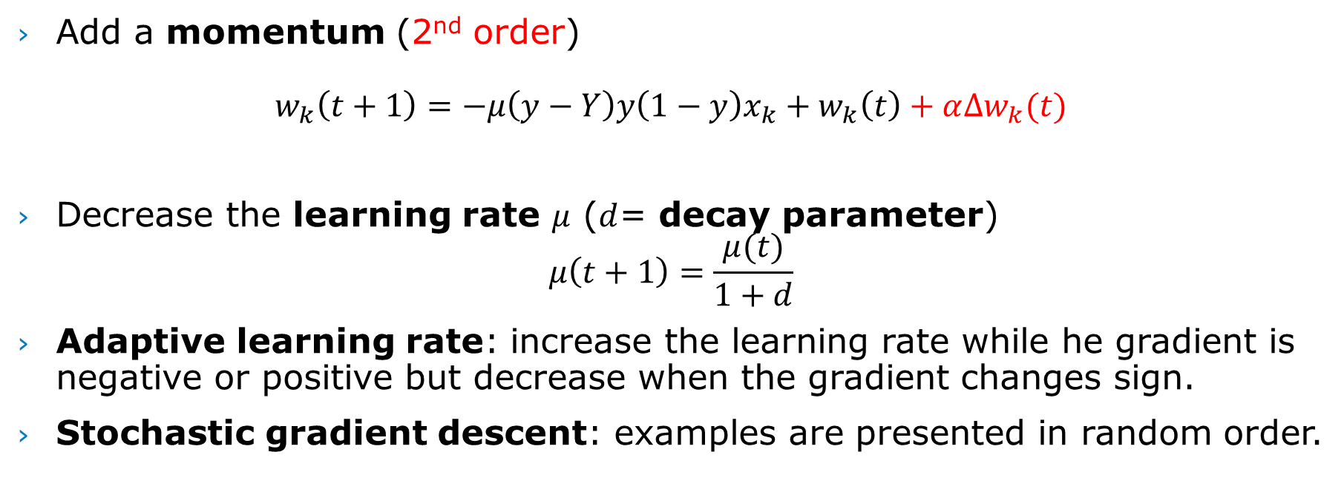
Improvements
Add a momentum (2nd order)
$$w_{k}\left(t+1\right)=−μ\left(y−Y\right)y\left(1−y\right)x_{k}+w_{k}\left(t\right)+α∆w_{k}(t)$$
Decrease the learning rate $μ$ ($d$= decay parameter) $μ\left(t+1\right)=\frac{μ(t)}{1+d}$
Adaptive learning rate: increase the learning rate while he gradient is negative or positive but decrease when the gradient changes sign.
Stochastic gradient descent: examples are presented in random order.

Slide 19
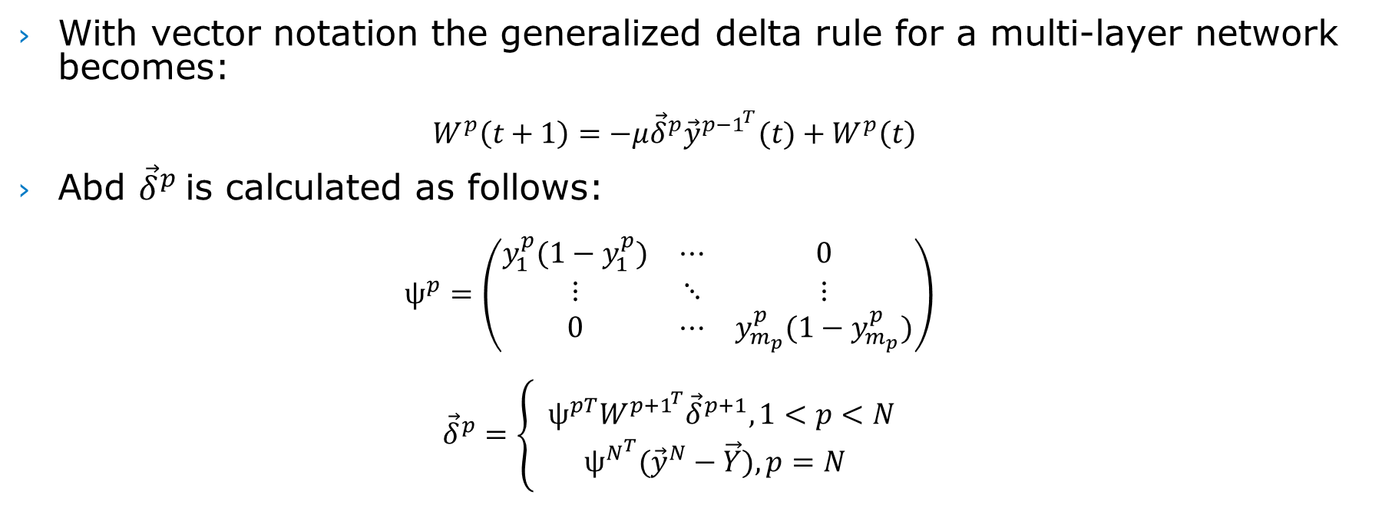
Back Propagation (1986)
With vector notation the generalized delta rule for a multi-layer network becomes: $W^{p}\left(t+1\right)=−μ{\vec{δ}}^{p}{\vec{y}}^{{p−1}^{T}}(t)+W^{p}\left(t\right)$
Abd ${\vec{δ}}^{p}$is calculated as follows:
$$ψ^{p}=\left(\begin{matrix}y_{1}^{p}(1−y_{1}^{p}) & ⋯ & 0 \\ ⋮ & ⋱ & ⋮ \\ 0 & ⋯ & y_{m_{p}}^{p}(1−y_{m_{p}}^{p})\end{matrix}\right) \\ {\vec{δ}}^{p}=\left\{\begin{aligned}{ ψ}^{pT}W^{{p+1}^{T}}{\vec{δ}}^{p+1}, 1<p<N \\ ψ^{N^{T}}({\vec{y}}^{N}−\vec{Y}), p=N\end{aligned}\right.$$

Slide 20
The rise of deep learning
In 1986 Rumelhart, Hinton en Williams publish their article “Learning representations by back propagating errors” in Nature.
In the 90’s neural networks seem to be forgotten but the team of Le Cun, amongst others, continued working on deep neural networks (eg. LeNet 1998).
Beginning of the 2000’s neural networks were not very popular but a number of groups continued…

Slide 21
The rise of deep learning
Because of the introduction of GPU’s and large datasets (as a result from the internet) machine learning systems rapidly improved.
Starting 2010 deep learning is responsible for a new breakthrough in 2012…
… when Hinton and team win the ImageNet competition (ILSVRC) with AlexNet, an improved deep neural network.
The performance improvement was so impressive that subsequent years others continued improving the deep learning principles in AlexNet.

Slide 22
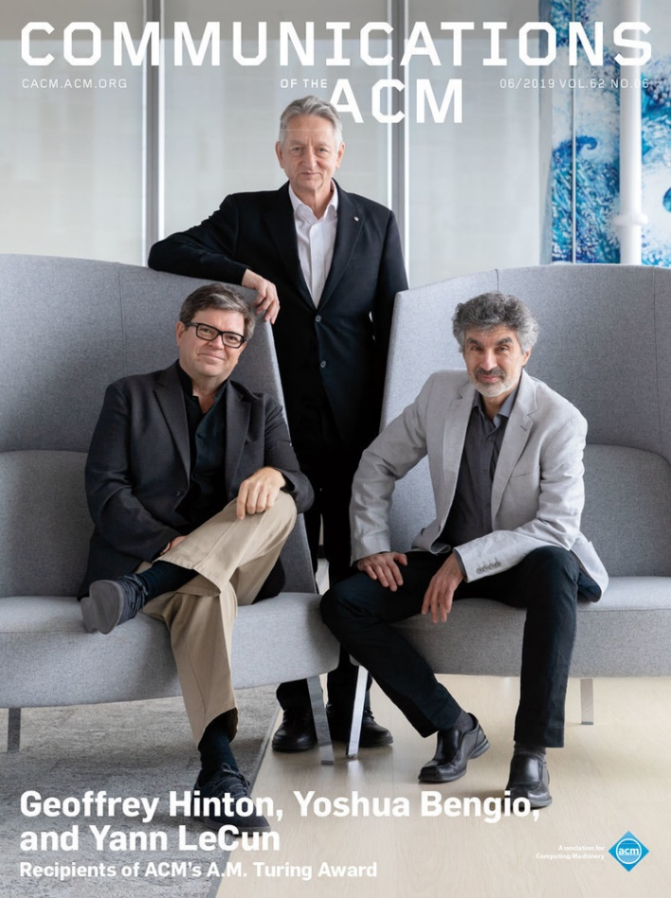

ACM A.M. Turing Award 2018
Yoshua Bengio, Yan Lecun and Geoffrey Hinton
Also see: https://www.youtube.com/watch?v=HzilDIhWhrE

Slide 23
ImageNet
Classification of pictures with a deep neural network

Slide 24
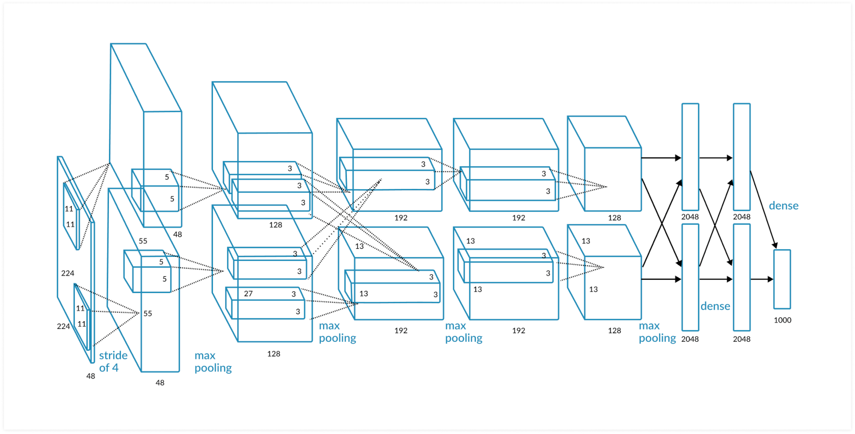
ImageNet deep neural network
AlexNet wins ImageNet competition in 2012

Slide 25

How does AlexNet work?
Notes:
https://www.youtube.com/watch?v=jajksuQW4mc

Slide 26
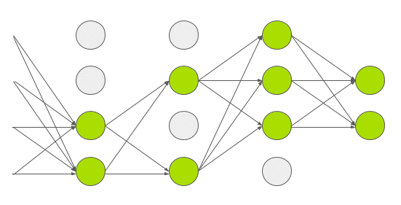
Imagenet improvements
The Sigmoid function is replaced by a Rectified Linear Unit (next slide).
Number of parameters reduced by pooling.
Prevent “overfitting” by:
Data Augmentation: Vary input data, e.g. present mirror images,, random cropping
Dropouts: every neuron fails 50% of the time. A neuron that fails does not participate in forward and backward propagation

Slide 27
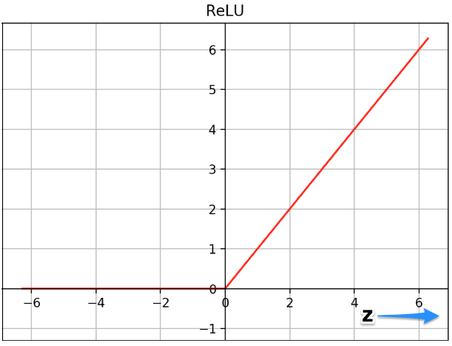
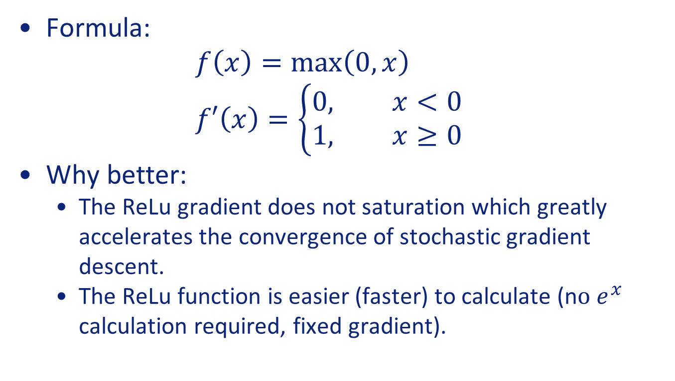
Rectified Linear Unit (ReLU)
Formula: $f\left(x\right)=\max\left(0,x\right)$ $f′\left(x\right)=\left\{\begin{aligned}0, x<0 \\ &1, x≥0\end{aligned}\right.$
Why better:
The ReLu gradient does not saturation which greatly accelerates the convergence of stochastic gradient descent.
The ReLu function is easier (faster) to calculate (n$o e^{x}$ calculation required, fixed gradient).

Slide 28
Why is AlexNet so much better?
Deep neural networks have many more layers and are trained with many more examples on faster computers.
Simplified models are easier to calculate.
Simulation and training have been speed up by the use of GPU’s and later by special Tensor Processing Units (TPU’s).
A deep neural network model that has been trained once, is familiar with the input date and can specialise with a smaller training set.

Slide 29
Word2Vec
Semantic representation of words with vectors

Slide 30
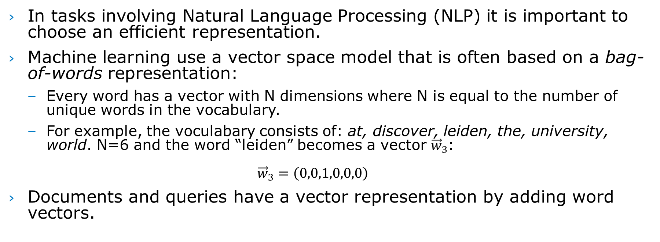
Machine learning and language
In tasks involving Natural Language Processing (NLP) it is important to choose an efficient representation.
Machine learning use a vector space model that is often based on a bag-of-words representation:
Every word has a vector with N dimensions where N is equal to the number of unique words in the vocabulary.
For example, the voculabary consists of: at, discover, leiden, the, university, world. N=6 and the word “leiden” becomes a vector ${\vec{w}}_{3}$: ${\vec{w}}_{3}=\left(0,0,1,0,0,0\right)$
Documents and queries have a vector representation by adding word vectors.

Slide 31
Bag-of-words disadvantages
The sequencing of words in a text are lost.
The similarity between two words (the inner product of their vectors) is always 0, even words that are related.
The number of unique words is large. N can easily be 20.000.
To cope with these down sides, various improvements have been introduced, e.g. Latent Semantic Indexing (LSI or LSA) and Latent Dirichlet Allocation (LDA)
However, such methods are computationally expensive.

Slide 32
Word2Vec: word embeddings
Invented by Google in 2013. Word2vec is not a deep but a shallow neural network.
Word2vec has been constructed to investigate if a neural network is capable of learning better word vectors.
The result is spectacular because word2vec:
Learns vectors so that words with the same context have similar vectors
meaning that stemming is no longer required
and word relations are embedded in vector space! E.g.: Paris - France + Italy = Rome King – Man + Woman = Queen
Hence, these vectors are also known as word embeddings

Slide 33
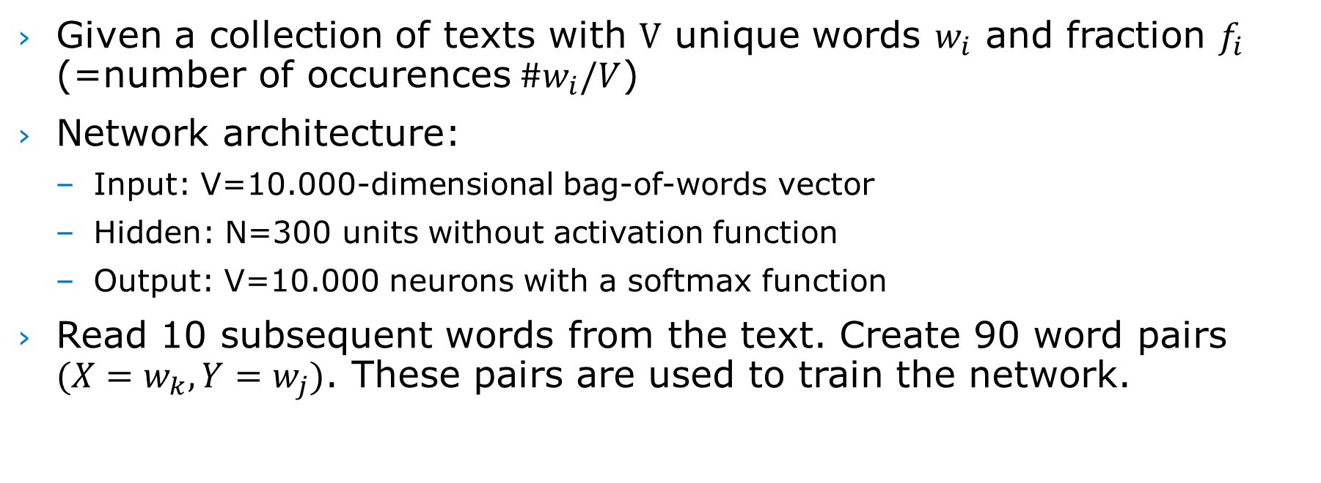
How does Word2Vec work?
Given a collection of texts with $V$ unique words $w_{i}$ and fraction $f_{i}$ (=number of occurences${\#w}_{i}/V$)
Network architecture:
Input: V=10.000-dimensional bag-of-words vector
Hidden: N=300 units without activation function
Output: V=10.000 neurons with a softmax function
Read 10 subsequent words from the text. Create 90 word pairs ${(X=w}_{k}, Y=w_{j})$. These pairs are used to train the network.
Notes:
https://www.youtube.com/watch?v=xMwx2A_o5r4

Slide 34
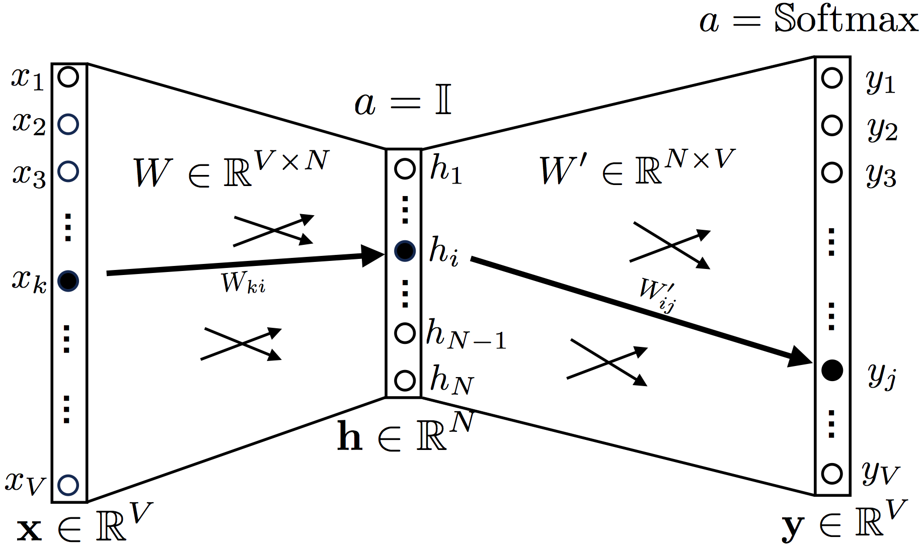
Word2Vec network

Slide 35
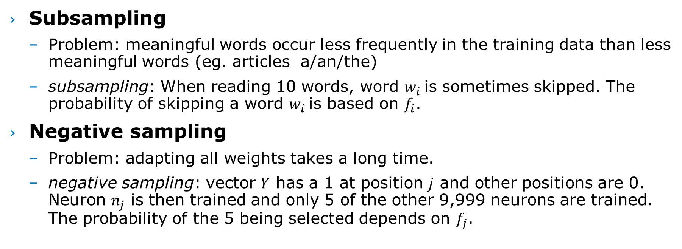
Word2Vec optimalisations
Subsampling
Problem: meaningful words occur less frequently in the training data than less meaningful words (eg. articles a/an/the)
subsampling: When reading 10 words, word $w_{i}$is sometimes skipped. The probability of skipping a word $w_{i}$is based on $f_{i}$.
Negative sampling
Problem: adapting all weights takes a long time.
negative sampling: vector $Y$ has a 1 at position $j$ and other positions are 0. Neuron $n_{j}$ is then trained and only 5 of the other 9,999 neurons are trained. The probability of the 5 being selected depends on $f_{j}$.

Slide 36

Word2Vec weight matrix
$X$is the input vector, $W$ is the weight matrix of the hidden layer: $X=\left({\begin{aligned}x_{1} \\ ⋮\end{aligned} \atop x_{10.000}}\right),x_{i}=\left\{\begin{aligned}1, i=j \\ &0,i≠j\end{aligned}\right. W= \left(\begin{matrix}\begin{aligned}w_{1,1} \\ ⋮\end{aligned} & \begin{aligned}⋯ \\ ⋱\end{aligned} & \begin{aligned}w_{1,10.000} \\ ⋮\end{aligned} \\ w_{300,1} & ⋯ & w_{300,10.000}\end{matrix}\right)$
The output of the hidden layer is a vector representation $H$for input word $w_{j}$: $H=W.X=\left({\begin{aligned}h_{1} \\ ⋮\end{aligned} \atop h_{300}}\right)$
After learning the output layer weight matrix $W$’ is discarded.

Slide 37
Exercise with Word2Vec
Link:
https://github.com/HansHenseler/DFRWS-APAC-LLM-Workshop
Notebooks:
Part I.A: Explaining word embeddings with Word2Vec
Part I.B: Generating text with Recurrent Neural Networks (RNNs)
Part I.C: BERT: Bidirectional Encoder Representations from Transformers
Requirements:
Google CoLab is free but you need a Gmail account!
Account for accessing free version of OpenAI ChatGPT
Make sure to select a T4 GPU

Slide 38
Recurrent Neural Networks
Generating text by self-supervised learning on large character sequences

Slide 39
Disadvantages of Word2Vec
Can only represent known words:
There is no vector available for a word that doesn’t occur in the training set (you can try in the notebook and see what happens).
The context of a word is not represented in the word embedding:
Word2Vec can only provide one vector for bank regardless of it’s context:
I’m at the river bank
I have a bank account
Ideally we should take the sequence of words into account
Recurrent Neural Network use the output of previous inputs together with new inputs

Slide 40



Recurrent Neural Network (RNN)
A RNN has a network F with one hidden layer with $\vec{h}$ at time $t−1$ which is fed back as input $\vec{x}$ at time $t$.
The activation function of an RNN is: ${\vec{h}}_{t}=f(W∙{\vec{x}}_{t}+U∙{\vec{h}}_{t−1})$ met $f\left(σ\right)=\frac{1}{(1+e^{−σ})}$
Notes:
https://adventuresinmachinelearning.com/keras-lstm-tutorial/
https://www.youtube.com/watch?v=H3ciJF2eCJI

Slide 41

Proccesing word sequences

Slide 42
Example: generating text
Generating text using an RNN with GRU units
Example is based on Shakespeare texts, e.g.:prompted with a word sequence, predict the next word.
By repeatedly applying this model it is possible to generate a text that looks like the text that the network learned during training.

Slide 43

From data to trainingset
Total length: 1.115.394 characters
65 unique characters. Convert to integers 0...64
First Citizen: Before we proceed any further, hear me speak.
All: Speak, speak.
First Citizen: You are all resolved rather to die than to famish?
All: Resolved. resolved. First
Citizen: First, you know Caius Marcius is chief enemy to the people.
'\n' | 0
' ' | 1
'!' | 2
'$' | 3
$$⋮$$ | $$⋮$$
'x' | 62
'y' | 63
'z' | 64

Slide 44
Selecting training sequences
Set training length=100.
Input sequence 100 characters: char[1]…[100].
The output is the same sequence but 1 character further:
char[2]…[101].
Network learns 100 examples:
(char[1], char[2]), (char[2], char[3]), …, (char[100],char[101]).
Total number of examples: 11.043
Input data: 'First Citizen:\nBefore we proceed any further, hear me speak.\n\nAll:\nSpeak, speak.\n\nFirst Citizen:\nYou’
Target data: 'irst Citizen:\nBefore we proceed any further, hear me speak.\n\nAll:\nSpeak, speak.\n\nFirst Citizen:\nYou ’
Input data: 'are all resolved rather to die than to famish?\n\nAll:\nResolved. resolved.\n\nFirst Citizen:\nFirst, you '
Target data: 're all resolved rather to die than to famish?\n\nAll:\nResolved. resolved.\n\nFirst Citizen:\nFirst, you k'
Input data: "now Caius Marcius is chief enemy to the people.\n\nAll:\nWe know't, we know't.\n\nFirst Citizen:\nLet us k"
Target data: "ow Caius Marcius is chief enemy to the people.\n\nAll:\nWe know't, we know't.\n\nFirst Citizen:\nLet us ki"

Slide 45
Training batches
One epoch means that all examples have been used once during training (randomly).
Tensorflow can process multiple examples in one batch. We set batch_size = 64.
Tensorflow is able to handle an infinite number of examples. Only a limited number of examples are loaded in memory. The buffer_size determines how many batches can be loaded in memory.
This buffer automatically takes care of random ordering of examples (shuffle or stochastic gradient descent).

Slide 46

Network architecture
Because the charset is limited to 65 characters it is possible to use an integer embedding layer. Dimension = 256
The hidden layer in the GRU network has 1,024 nodes
The output must be projected on 65 output nodes.

Slide 47
Exercise with Recurrent Neural Network
Link:
https://github.com/HansHenseler/DFRWS-APAC-LLM-Workshop
Notebooks:
Part I.A: Explaining word embeddings with Word2Vec
Part I.B: Generating text with Recurrent Neural Networks (RNNs)
Part I.C: BERT: Bidirectional Encoder Representations from Transformers
Requirements:
Google CoLab is free but you need a Gmail account!
Account for accessing free version of OpenAI ChatGPT
Make sure to select a T4 GPU

Slide 48
BERT
Representing text with word pieces and sentence embeddings

Slide 49
Disadvantages of Recurrent Neural Networks
An RNN has difficulties learning a connection between words that are far apart
An RNN can only look back and not ahead while context is determined by the complete sentence:
In “I’m at the river bank” the word river comes before the word bank while in “I have a bank account” the word account follows after the word bank.
Current GPU and TPU hardware accellerators are good in parallel processing but less efficient for sequential processing.
Transformers do not suffer from these disadvantages and perform considerably better than recurrent neurl networks.

Slide 50
BERT
BERT: Bidirectional Encoder Representations from Transformers
Application:
Transform seq to seq but uses attention (vs RNN)
Has been introduced by Google in 2018
Very successful in translation (e.g. Google translate)
Context-based representation:
Word2vec = context-free: For example, the word “bank” would have the same context-free representation in “bank account” and “bank of the river.”
BERT = context-based: represents “bank” using both its previous and next context — “I accessed the … account”

Slide 51
How does BERT work?
BERT has an encoder and a decoder part
Transformers (BERT) read all words at once:
Versus directional models that read text from left to right or right to left
This is why transformers are called bidirectional, but actually they are not directional.
Transformers can learn the context of a word based on it’s entire context, e.g., it can relate to words before as well as after.

Slide 52
BERT input
BERT input:
One or two sentences. The first sentence is preceded by a [CLS] marker and the second sentence by a [SEP] marker.
Example:
2 sentences:
[CLS] The man went to the store. [SEP] He bought a gallon of milk.
1 sentence:
[CLS] The man went to the store. [SEP]

Slide 53
BERT uses Word Piece(s)
WordPiece is an algorithm that is being used in natural language processing to segment sentences (tokenization).
The vocabulary is initialized with individual characters that occur in a collection of words (the language).
Next the most freqeuent combinations of characters are iteratively added to the vocabulary until the maximum number of words is reached.
BERT vocabulary
BERT English has 30K tokens.
BERT Multilingual has 110K tokens (104 languages)
See https://github.com/google-research/bert/blob/master/multilingual.md

Slide 54
Example: WordPieces in BERT
Tale a sentence and transform in tokens:
text = "Here is the sentence I want embeddings for."
marked_text = "[CLS] " + text + " [SEP]"
# Tokenize our sentence with the BERT tokenizer.
tokenized_text = tokenizer.tokenize(marked_text)
# Print out the tokens.
print (tokenized_text)
['[CLS]', 'here', 'is', 'the', 'sentence', 'i', 'want', 'em', '##bed', '##ding', '##s', 'for', '.', '[SEP]']
Note how the word ‘embeddings’ is represented:
['em', '##bed', '##ding', '##s']

Slide 55
BERT pre-trained models by Google
Model | Language | Architecture
BERT-Large, Uncased (Whole Word Masking) | English | 24-layer, 1024-hidden, 16-heads, 340M parameters
BERT-Large, Cased (Whole Word Masking) | English | 24-layer, 1024-hidden, 16-heads, 340M parameters
BERT-Base, Uncased | English | 12-layer, 768-hidden, 12-heads, 110M parameters
BERT-Large, Uncased | English | 24-layer, 1024-hidden, 16-heads, 340M parameters
BERT-Base, Cased | English | 12-layer, 768-hidden, 12-heads , 110M parameters
BERT-Large, Cased | English | 24-layer, 1024-hidden, 16-heads, 340M parameters
BERT-Base, Multilingual Cased (New, recommended) | 104 languages | 12-layer, 768-hidden, 12-heads, 110M parameters
BERT-Base, Multilingual Uncased (Orig, not recommended) (Not recommended, use Multilingual Cased instead) | 102 languages | 12-layer, 768-hidden, 12-heads, 110M parameters
BERT-Base, Chinese | Chinese Simplified and Traditional | 12-layer, 768-hidden, 12-heads, 110M parameters
https://github.com/google-research/bert#pre-trained-models

Slide 56
Exercise with BERT
Link:
https://github.com/HansHenseler/DFRWS-APAC-LLM-Workshop
Notebooks:
Part I.A: Explaining word embeddings with Word2Vec
Part I.B: Generating text with Recurrent Neural Networks (RNNs)
Part I.C: BERT: Bidirectional Encoder Representations from Transformers
Requirements:
Google CoLab is free but you need a Gmail account!
Account for accessing free version of OpenAI ChatGPT
Make sure to select a T4 GPU

Slide 57
Break 11:00-11:30
Time | Title
9:30 | Extra: Introduction to Neural Networks and Natural Language Processing
11:00 | Break
11:30 | Part I: Introduction Large Language Models
12:00 | Part II: Hands-on prompt engineering for digital forensics
12:30 | Lunch
14:00 | (part II continued)
14:30 | Part III: Hands-on with a LLM in a Google Colab notebook
15:30 | Break
16:00 | Part IV: Hands-on with Retrieval Augmented Generation
17:00 | End

